Slide 1
Module 6: Data Link Layer
Instructor Materials
Introduction to Networks v7.0 (ITN)
Notes:
Cisco Networking Academy Program
Introduction to Networks v7.0 (ITN)
Module 6: Data Link Layer

Slide 2
Instructor Materials – Module 6 Planning Guide
This PowerPoint deck is divided in two parts:
Instructor Planning Guide
Information to help you become familiar with the module
Teaching aids
Instructor Class Presentation
Optional slides that you can use in the classroom
Begins on slide # 9
Note: Remove the Planning Guide from this presentation before sharing with anyone.
For additional help and resources go to the Instructor Home Page and Course Resources for this course. You also can visit the professional development site on netacad.com, the official Cisco Networking Academy Facebook page, or Instructor Only FB group.
Notes:
2

Slide 3
What to Expect in this Module
To facilitate learning, the following features within the GUI may be included in this module:
Feature | Description
Animations | Expose learners to new skills and concepts.
Videos | Expose learners to new skills and concepts.
Check Your Understanding(CYU) | Per topic online quiz to help learners gauge content understanding.
Interactive Activities | A variety of formats to help learners gauge content understanding.
Syntax Checker | Small simulations that expose learners to Cisco command line to practice configuration skills.
PT Activity | Simulation and modeling activities designed to explore, acquire, reinforce, and expand skills.

Slide 4
What to Expect in this Module (Cont.)
To facilitate learning, the following features may be included in this module:
Feature | Description
Hands-On Labs | Labs designed for working with physical equipment.
Class Activities | These are found on the Instructor Resources page. Class Activities are designed to facilitate learning, class discussion, and collaboration.
Module Quizzes | Self-assessments that integrate concepts and skills learned throughout the series of topics presented in the module.
Module Summary | Briefly recaps module content.

Slide 5
Check Your Understanding
Check Your Understanding activities are designed to let students quickly determine if they understand the content and can proceed, or if they need to review.
Check Your Understanding activities do not affect student grades.
There are no separate slides for these activities in the PPT. They are listed in the notes area of the slide that appears before these activities.
Notes:
5

Slide 6
Module 6: Activities
What activities are associated with this module?
Page # | Activity Type | Activity Name | Optional?
6.1.5 | Check Your Understanding | Purpose of the Data Link Layer | Recommended
6.2.9 | Check Your Understanding | Topologies | Recommended
6.3.5 | Check Your Understanding | Data Link Frame | Recommended
6.4.2 | Module Quiz | Data Link Layer | Recommended
Notes:
6

Slide 7
Module 6: Best Practices
Prior to teaching Module 6, the instructor should:
Review the activities and assessments for this module.
Try to include as many questions as possible to keep students engaged during classroom presentation.
Topic 6.1
Ask the students or have a class discussion
Discuss the functions of the data link layer.
What would be the consequences on upper layer protocols if there was no data link layer?
Topic 6.2
Ask the students or have a class discussion
What type of logical topology do they use on their home network?
Why is CSMA/CA more appropriate than CSMA/CD for wireless networks?
Notes:
7

Slide 8
Module 6: Best Practices (Cont.)
Topic 6.3
Ask the students or have a class discussion
Discuss the function of the six frame fields.
What is the Layer 2 address of their personal computer or laptop?
Notes:
8

Slide 9
Module 6: Data Link Layer
Introduction to Networks v7.0 (ITN)
Notes:
Cisco Networking Academy Program
Introduction to Networks v7.0 (ITN)
Module 6: Data Link Layer

Slide 10
Module Objectives
Module Title: Data Link Layer
Module Objective: Explain how media access control in the data link layer supports communication across networks.
Topic Title | Topic Objective
Purpose of the Data Link Layer | Describe the purpose and function of the data link layer in preparing communication for transmission on specific media.
Topologies | Compare the characteristics of media access control methods on WAN and LAN topologies.
Data Link Frame | Describe the characteristics and functions of the data link frame.
Notes:
10
6.0 - Data Link Layer - Introduction
6.0.2 – What will I learn to do in this module?

Slide 11
6.1 Purpose of the Data Link Layer
Notes:
6 - Data Link Layer
6.1 - Purpose of the Data Link Layer

Slide 12
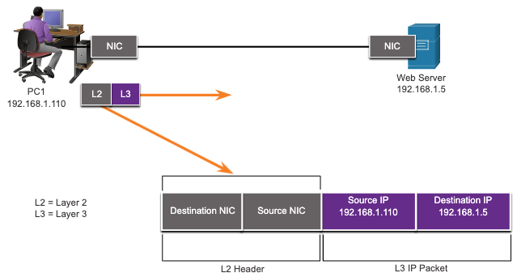
Purpose of the Data Link Layer The Data Link Layer
The Data Link layer is responsible for communications between end-device network interface cards.
It allows upper layer protocols to access the physical layer media and encapsulates Layer 3 packets (IPv4 and IPv6) into Layer 2 Frames.
It also performs error detection and rejects corrupts frames.
Notes:
6 – Data Link Layer
6.1 – Purpose of the Data Link Layer
6.1.1 – The Data Link Layer

Slide 13
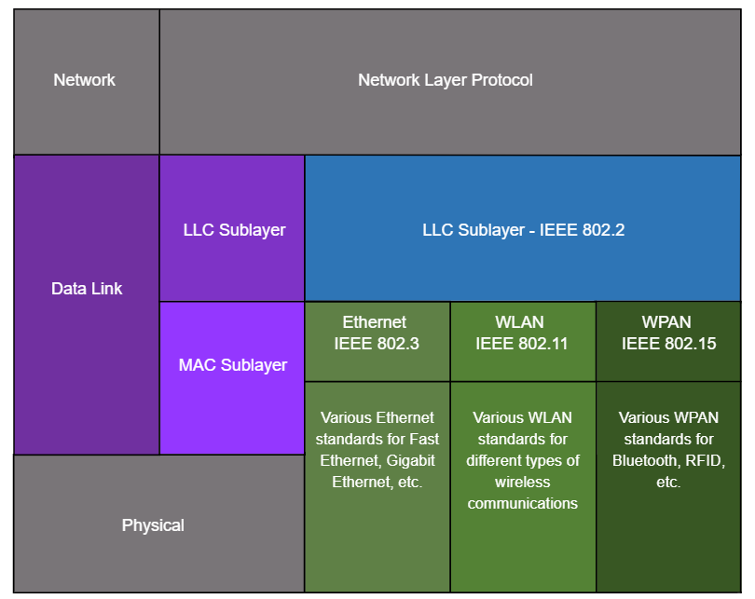
Purpose of the Data Link Layer IEEE 802 LAN/MAN Data Link Sublayers
IEEE 802 LAN/MAN standards are specific to the type of network (Ethernet, WLAN, WPAN, etc).
The Data Link Layer consists of two sublayers. Logical Link Control (LLC) and Media Access Control (MAC).
The LLC sublayer communicates between the networking software at the upper layers and the device hardware at the lower layers.
The MAC sublayer is responsible for data encapsulation and media access control.
Notes:
6 – Data Link Layer
6.1 – Purpose of the Data Link Layer
6.1.2 – IEEE 802 LAN/MAN Data Link Sublayers

Slide 14
Purpose of the Data Link Layer Providing Access to Media
Packets exchanged between nodes may experience numerous data link layers and media transitions.
At each hop along the path, a router performs four basic Layer 2 functions:
Accepts a frame from the network medium.
De-encapsulates the frame to expose the encapsulated packet.
Re-encapsulates the packet into a new frame.
Forwards the new frame on the medium of the next network segment.
Notes:
6 – Data Link Layer
6.1 – Purpose of the Data Link Layer
6.1.3 – Providing Access to Media

Slide 15

Purpose of the Data Link Layer Data Link Layer Standards
Data link layer protocols are defined by engineering organizations:
Institute for Electrical and Electronic Engineers (IEEE).
International Telecommunications Union (ITU).
International Organizations for Standardization (ISO).
American National Standards Institute (ANSI).
Notes:
6 – Data Link Layer
6.1 – Purpose of the Data Link Layer
6.1.4 – Data Link Layer Standards
6.1.5 – Check Your Understanding – Purpose of Data Link Layer

Slide 16
6.2 Topologies
Notes:
6 - Data Link Layer
6.2 - Topologies

Slide 17
Topologies Physical and Logical Topologies
The topology of a network is the arrangement and relationship of the network devices and the interconnections between them.
There are two types of topologies used when describing networks:
Physical topology – shows physical connections and how devices are interconnected.
Logical topology – identifies the virtual connections between devices using device interfaces and IP addressing schemes.
Notes:
6 – Data Link Layer
6.2 – Topologies
6.2.1 – Physical and Logical Topologies

Slide 18
Topologies WAN Topologies
There are three common physical WAN topologies:
Point-to-point – the simplest and most common WAN topology. Consists of a permanent link between two endpoints.
Hub and spoke – similar to a star topology where a central site interconnects branch sites through point-to-point links.
Mesh – provides high availability but requires every end system to be connected to every other end system.
Notes:
6 – Data Link Layer
6.2 – Topologies
6.2.2 – WAN Topologies

Slide 19
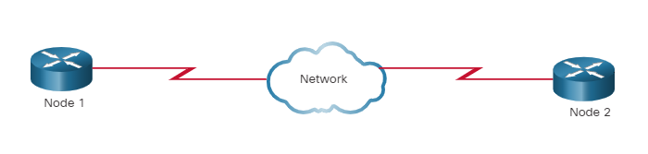
Topologies Point-to-Point WAN Topology
Physical point-to-point topologies directly connect two nodes.
The nodes may not share the media with other hosts.
Because all frames on the media can only travel to or from the two nodes, Point-to-Point WAN protocols can be very simple.
Notes:
6 – Data Link Layer
6.2 – Topologies
6.2.3– Point-to-Point WAN Topology

Slide 20
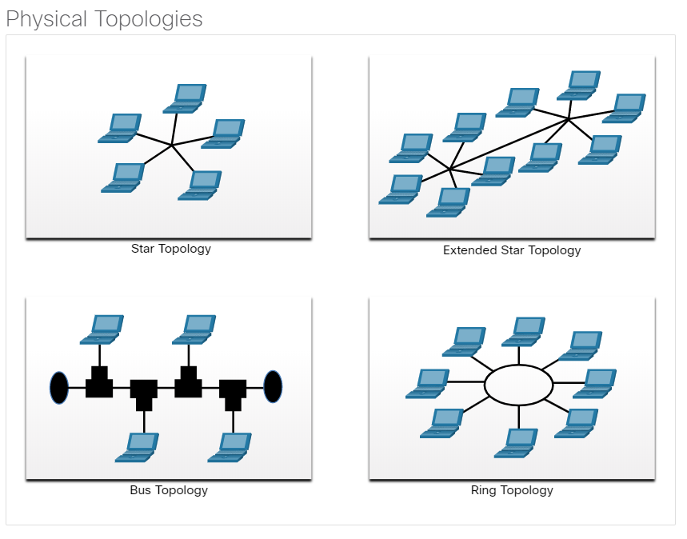
Topologies LAN Topologies
End devices on LANs are typically interconnected using a star or extended star topology. Star and extended star topologies are easy to install, very scalable and easy to troubleshoot.
Early Ethernet and Legacy Token Ring technologies provide two additional topologies:
Bus – All end systems chained together and terminated on each end.
Ring – Each end system is connected to its respective neighbors to form a ring.
Notes:
6 – Data Link Layer
6.2 – Topologies
6.2.4 – LAN Topologies

Slide 21
Topologies Half and Full Duplex Communication
Half-duplex communication
Only allows one device to send or receive at a time on a shared medium.
Used on WLANs and legacy bus topologies with Ethernet hubs.
Full-duplex communication
Allows both devices to simultaneously transmit and receive on a shared medium.
Ethernet switches operate in full-duplex mode.
Notes:
6 – Data Link Layer
6.2 – Topologies
6.2.5 – Half and Full Duplex Communication

Slide 22
Topologies Access Control Methods
Contention-based access
All nodes operating in half-duplex, competing for use of the medium. Examples are:
Carrier sense multiple access with collision avoidance (CSMA/CA) as used on Wireless LANs.
Carrier sense multiple access with collision detection (CSMA/CD) as used on legacy bus-topology Ethernet.
Controlled access
Deterministic access where each node has its own time on the medium.
Used on legacy networks such as Token Ring and ARCNET.
Notes:
6 – Data Link Layer
6.2 – Topologies
6.2.6 – Access Control Methods

Slide 23
Topologies Signal Collision – What is it?
Definition
A signal collision occurs when two or more devices attempt to transmit data over a shared communication medium at the same time.
In wired networks, this shared medium could be a single cable (like in Ethernet bus topologies) or a segment connected via a hub.
Impact
When a collision happens, the signals from the transmitting devices interfere with each other, resulting in a garbled signal (lộn xộn) that cannot be correctly interpreted by any receiving device.
Notes:
6 – Data Link Layer
6.2 – Topologies
6.2.8 – Contention-Based Access – CSMA/CA
6.2.9 – Check Your Understanding - Topologies

Slide 24
Topologies Signal Collision – How to detect?
Carrier Sensing
Before transmitting, a device listens to the communication medium to determine if it is currently being used. If the medium is free, the device proceeds with transmission.
Simultaneous Transmission
Despite the initial carrier sensing, it’s possible that two devices start transmitting at nearly the same time. Because they both sense the medium as free, they transmit their signals, leading to a collision.
Notes:
6 – Data Link Layer
6.2 – Topologies
6.2.8 – Contention-Based Access – CSMA/CA
6.2.9 – Check Your Understanding - Topologies

Slide 25
Topologies Signal Collision – How to detect? (cont’d)
Collision Detection Mechanism
Signal Monitoring: While transmitting, each device also monitors the medium for changes in voltage or signal strength.
Garbling (hiện tượng méo dữ liệu): If a collision occurs, the signals from the two transmitting devices interfere with each other, causing an abrupt change (thay đổi bất ngờ) in the signal’s characteristics. This change is detected as a collision.
Jamming Signal: In Ethernet networks, when a collision is detected, devices send a jamming signal to ensure that all devices on the network recognize the collision.
Only Ethernet need to use the collision detection mechanism, not WLAN, why?
Notes:
6 – Data Link Layer
6.2 – Topologies
6.2.8 – Contention-Based Access – CSMA/CA
6.2.9 – Check Your Understanding - Topologies

Slide 26
Topologies Collision Detection Challenges of WLAN
Inability to Detect Collisions
In a wireless network, it is difficult to detect collisions because when a device is transmitting, it cannot simultaneously listen to the channel for other signals due to the significant difference in power levels between the transmitted signal and any potential incoming signals.
Hidden Node Problem
Wireless devices may not be able to detect each other directly if they are out of each other's range, but both can communicate with an access point. This means one device might start transmitting without knowing that another device is also transmitting to the same access point, causing a collision at the access point.
Notes:
6 – Data Link Layer
6.2 – Topologies
6.2.8 – Contention-Based Access – CSMA/CA
6.2.9 – Check Your Understanding - Topologies

Slide 27
Topologies Collision Detection Challenges of WLAN (cont’d)
Transmission Power vs. Reception Sensitivity
When a wireless device transmits, the power of its transmitted signal is quite high compared to the signals it would receive from other devices. For instance, a Wi-Fi device might transmit at a power level of around 100 milliwatts (mW).
However, the signals that it receives from other devices, especially those far away, might be received at power levels as low as a few microwatts (µW).
Interference from Own Transmission
While transmitting, the device's own signal dominates its receiver circuits due to the high power level. This strong signal can interfere with the device's ability to detect much weaker incoming signals from other devices.
The receiver’s sensitivity is typically set to detect weak signals, but the strong signal from its own transmitter can cause interference, effectively "deafening“ (gây điếc) the receiver to any other incoming signals during transmission.
Notes:
6 – Data Link Layer
6.2 – Topologies
6.2.8 – Contention-Based Access – CSMA/CA
6.2.9 – Check Your Understanding - Topologies

Slide 28
Topologies Contention-Based Access – CSMA/CA
CSMA/CA
Used by IEEE 802.11 WLANs.
Operates in half-duplex mode where only one device sends or receives at a time.
Uses a collision avoidance process to govern when a device can send and what happens if multiple devices send at the same time.
CSMA/CA collision avoidance process:
When transmitting, devices also include the time duration needed for the transmission.
Other devices on the shared medium receive the time duration information and know how long the medium will be unavailable.
Notes:
6 – Data Link Layer
6.2 – Topologies
6.2.8 – Contention-Based Access – CSMA/CA
6.2.9 – Check Your Understanding - Topologies

Slide 29
Topologies Contention-Based Access – CSMA/CD
CSMA/CD
Used by legacy Ethernet LANs.
Operates in half-duplex mode where only one device sends or receives at a time.
Uses a collision detection process to govern when a device can send and what happens if multiple devices send at the same time.
CSMA/CD collision detection process:
Devices transmitting simultaneously will result in a signal collision on the shared media.
Devices detect the collision.
Devices wait a random period of time and retransmit data.
Notes:
6 – Data Link Layer
6.2 – Topologies
6.2.7 – Contention-Based Access – CSMA/CD

Slide 30
6.3 Data Link Frame
Notes:
6 - Data Link Layer
6.3 - Data Link Frame

Slide 31
Data Link Frame The Frame
Data is encapsulated by the data link layer with a header and a trailer to form a frame.
A data link frame has three parts:
Header
Data
Trailer
The fields of the header and trailer vary according to data link layer protocol.
The amount of control information carried with in the frame varies according to access control information and logical topology.
Notes:
6 – Data Link Layer
6.3 – Data Link Frame
6.3.1 – The Frame

Slide 32
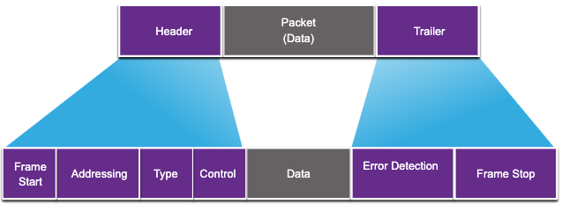
Data Link Frame Frame Fields
Field | Description
Frame Start and Stop | Identifies beginning and end of frame
Addressing | Indicates source and destination nodes
Type | Identifies encapsulated Layer 3 protocol
Control | Identifies flow control services
Data | Contains the frame payload
Error Detection | Used for determine transmission errors
Notes:
6 – Data Link Layer
6.3 – Data Link Frame
6.3.2 – Frame Fields

Slide 33
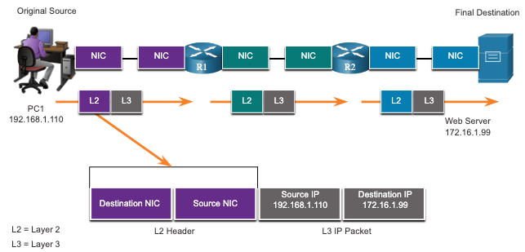
Data Link Frame Layer 2 Addresses
Also referred to as a physical address.
Contained in the frame header.
Used only for local delivery of a frame on the link.
Updated by each device that forwards the frame.
Notes:
6 – Data Link Layer
6.3 – Data Link Frame
6.3.3 – Layer 2 Address

Slide 34
Data Link Frame LAN and WAN Frames
The logical topology and physical media determine the data link protocol used:
Ethernet
802.11 Wireless
Point-to-Point (PPP)
High-Level Data Link Control (HDLC)
Frame-Relay
Each protocol performs media access control for specified logical topologies.
Notes:
6 – Data Link Layer
6.3 – Data Link Frame
6.3.4 – LAN and WAN Frames
6.3.5 – Check Your Understanding – Data Link Frame

Slide 35
6.4 Module Practice and Quiz
Notes:
6- Data Link Layer
6.4 - Module Practice and Quiz

Slide 36
Module Practice and Quiz What did I learn in this module?
The data link layer of the OSI model (Layer 2) prepares network data for the physical network.
The data link layer is responsible for network interface card (NIC) to network interface card communications.
The IEEE 802 LAN/MAN data link layer consists of the following two sublayers: LLC and MAC.
The two types of topologies used in LAN and WAN networks are physical and logical.
Three common types of physical WAN topologies are: point-to-point, hub and spoke, and mesh.
Half-duplex communications exchange data in one direction at a time. Full-duplex sends and receives data simultaneously.
In contention-based multi-access networks, all nodes are operating in half-duplex.
Examples of contention-based access methods include: CSMA/CD for bus-topology Ethernet LANs and CSMA/CA for WLANs.
The data link frame has three basic parts: header, data, and trailer.
Frame fields include: frame start and stop indicator flags, addressing, type, control, data, and error detection.
Data link addresses are also known as physical addresses.
Data link addresses are only used for link local delivery of frames.
Notes:
6 – Data Link Layer
6.4 – Module Practice and Quiz
6.4.1 – What did I learn in this module?
6.4.2 – Module Quiz – Data Link Layer

Slide 37
Module 6: Data Link Layer New Terms and Commands
Logical Link Control (LLC) Medial Access Control (MAC) Institute of Electrical and Electronic Engineers (IEEE) International Telecommunications Union (ITU) International Organization for Standardization (ISO) American National Standards Institute (ANSI) Physical Topology Logical Topology Half-duplex Full-duplex CSMA/CD CSMA/CA | Cyclic Redundancy Check (CRC) Contention-based access Controlled access

